Slide 1
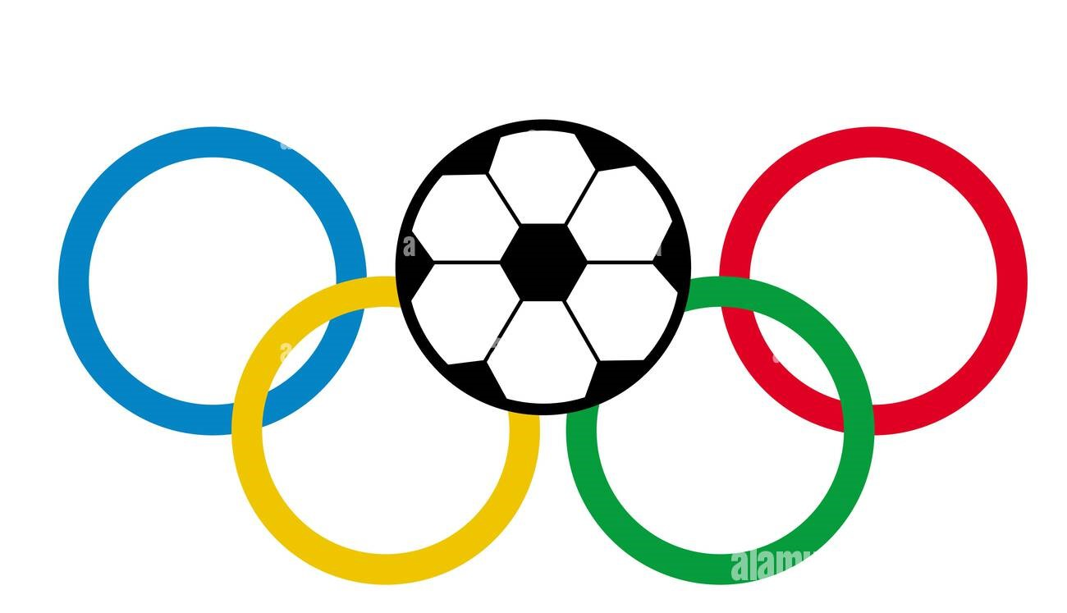
FIFFA OLYMPICS

Slide 2
INTRODUCTION
The FIFA Olympic football tournament, held every four years, features under-23 national teams from around the world, with each team allowed to include a limited number of overage players.
This tournament showcases emerging talent on an international stage and is often seen as a stepping stone for young players aiming for future success in senior football.
The competition is known for its passionate atmosphere, as countries vie for Olympic glory, blending the prestige of the Olympics with the excitement of football.
Notable past winners include Brazil, Argentina, and Nigeria, each leaving a significant mark on the tournament's history.

Slide 3
SPECIAL AWARDS OF FIFA
.
.
Ballon d’ Or :(2023) Lionel Messi
FIFA World Player of the Year : (2022): Karim Benzema
Golden Boot :
World Cup (2022): Kylian Mbappé (France) - 8 goals
Premier League :Erling Haaland (Manchester City) – 36 goals
Golden Glove
FIFA World Cup (2022): Emiliano Martínez (Argentina)
Premier League (2022-23): Ederson (Manchester City)
PFA Players' Player of the Year:
(2023): Erling Haaland (Manchester City)

Slide 4
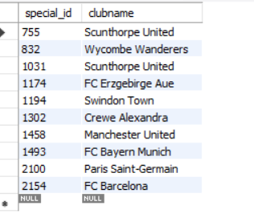
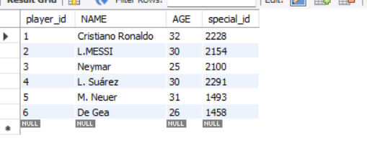
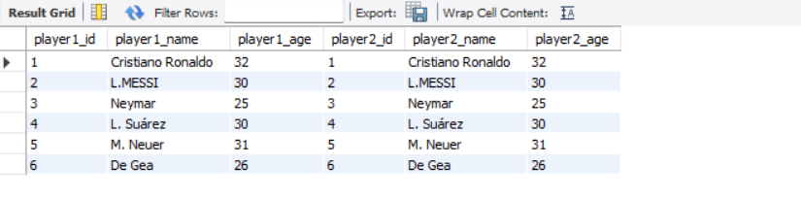
SQL ANALYSIS
TABLE 1 :
(Left table )
TABLE 2 :
(Right table )
SELF JOIN :
Self join Comparing rows within the same table.
https://drive.google.com/file/d/1eTnqr5L94BqQXZ1loVhnLSbp4j94xTeL/view?usp=sharing SQL LINK FOR FIFA OLYMPICS

Slide 5
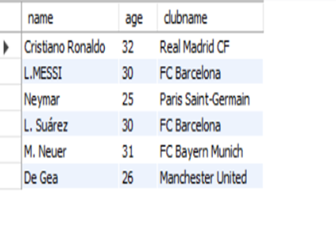
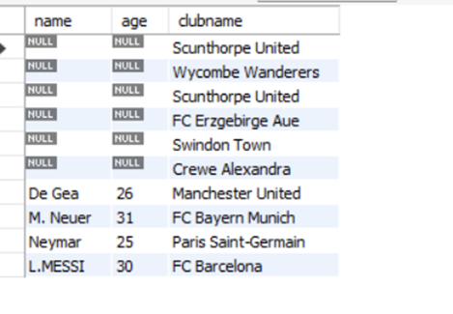
LEFT JOIN :
Useful when you want to retain all records from the left table, regardless of whether there is a matching record in the right table.
RIGHT JOIN :
Returns all rows from the right table and the matched rows from the left table. If there is no match, NULL values are returned for columns from the left table

Slide 6
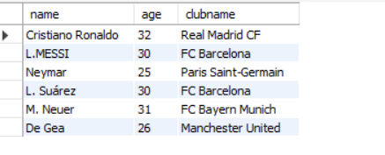
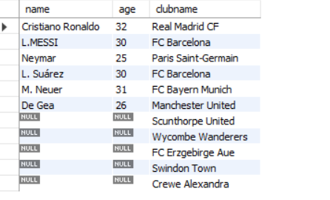
Inner join :
Only matching rows from both tables.
Full join:
All rows from both tables, with NULLs where there are no matches.
Cross join:
when you want to generate all combinations of data from two tables.

Slide 7
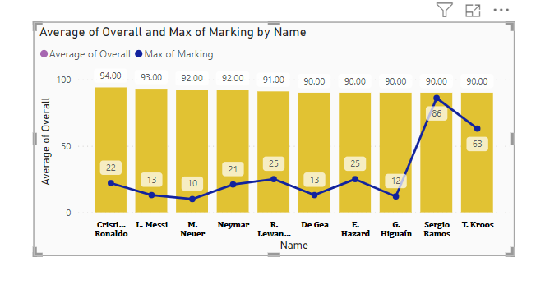
FROM THIS ANALYSIS
OVERALL RATING IS HIGH IN CASE OF CRISTIANO RONALDO WITH RATING OF 94
MAX MARKING REPRESENT THE PEAK INTENSITY SERIGO RAMOS HAS MARKING 86
BOTH METRICS CAN IMPACT GAME OUTCOMES BY INFLUENCING OPPONENT OPPORTUNITITES

Slide 8
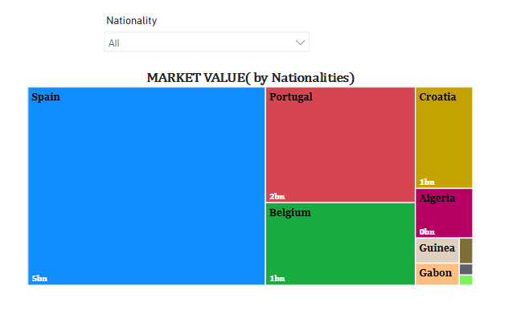
This analysis identifies which nationalities has the highest markert values , that in turn indicates the strong player production, and investment
Spain (5bm )
Portugal
Belgium
Croatia (1bm)

Slide 9
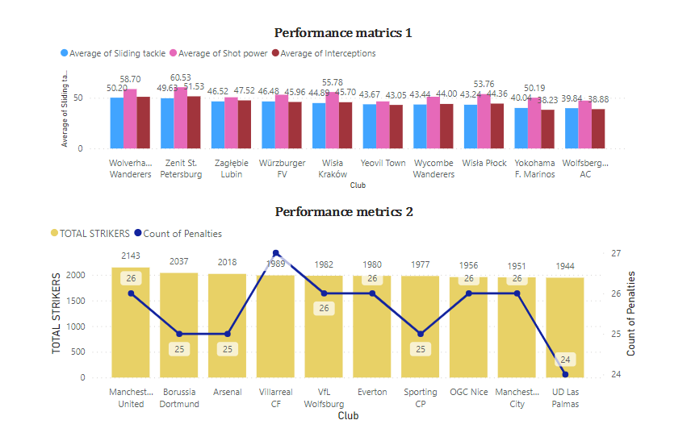
Defensive and offensive areas include the sliding tackle &shot power plays a key role in each game
Wolverhampton Wanderers ( 50 % sliding tackle )
Zenit St. Petersburg(60.53 shot power)
Strikers impact that how the squad depth influences overall play
Manchester United (2143)
Penalties also signifies the clubs integrity
Villarreal CF(27)

Slide 10
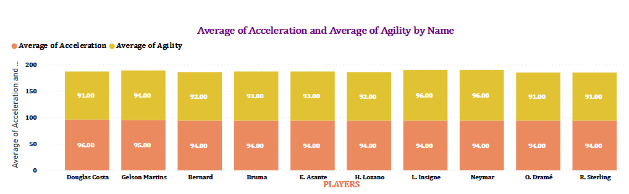
Acceleration refers to the ability of a player to quickly increase their speed from a standstill. It's crucial for making fast breaks
DOUGLAS COSTA HAS HIGHEST ACCELERATON OF 96
Agility involves the ability to change direction rapidly and effectively while maintaining control of the ball.
L.INSIGNE & NEYMAR share the top place
Both skills are essential for a player's overall performance on the field.

Slide 11
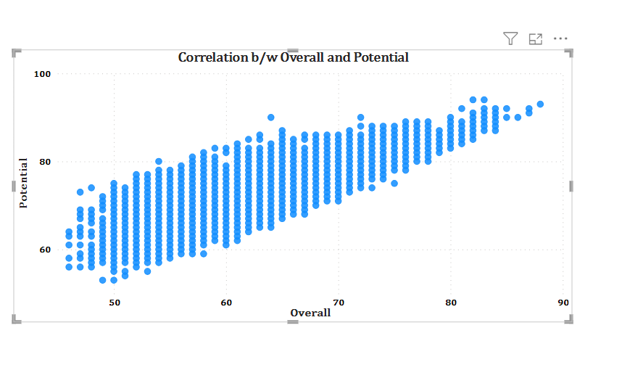
Upward direction of correlation indicates that as one variable increases, the other variable also tends to increase
In the context of soccer:
This suggests that players who currently perform well are also likely to continue improving. Such players are valuable assets for teams, as they can contribute significantly both in the present and in the future.

Slide 12
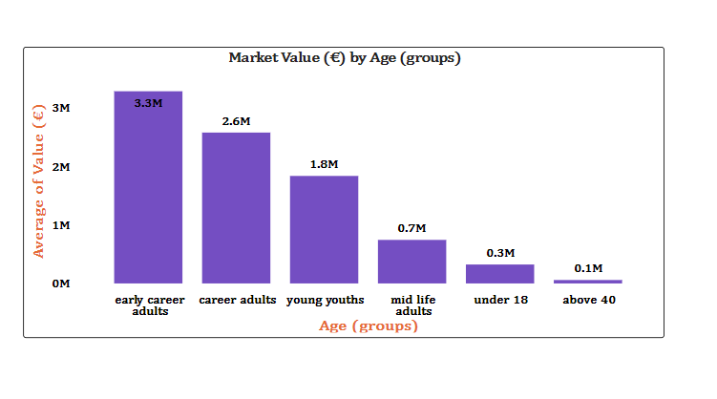
Market value of young adult soccer players tends to be high for several reasons:
If a young player is already performing well, clubs believe they can continue to improve and become even more valuable.
There’s often a strong demand for talented young players, especially in a competitive market where clubs are looking to secure future stars.

Slide 13
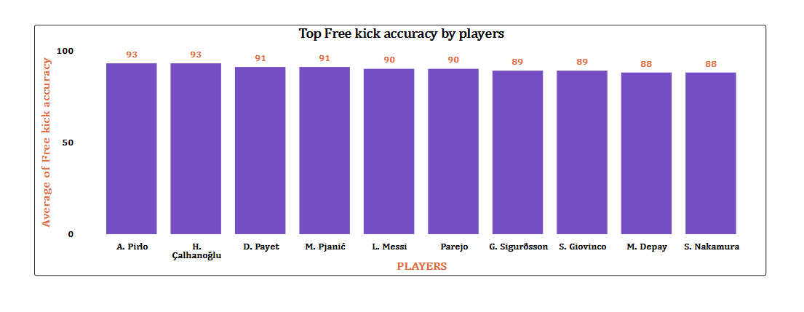
Accurate free kicks can lead directly to goals. Players who can consistently place the ball on target or into dangerous areas increase their team’s chances of scoring.
A.PIRLO Both share accuracy 93
H.CALHANOGLU
Teams with players known for their free kick accuracy can instill fear in opponents, leading to defensive adjustments and openings elsewhere on the field.

Slide 14
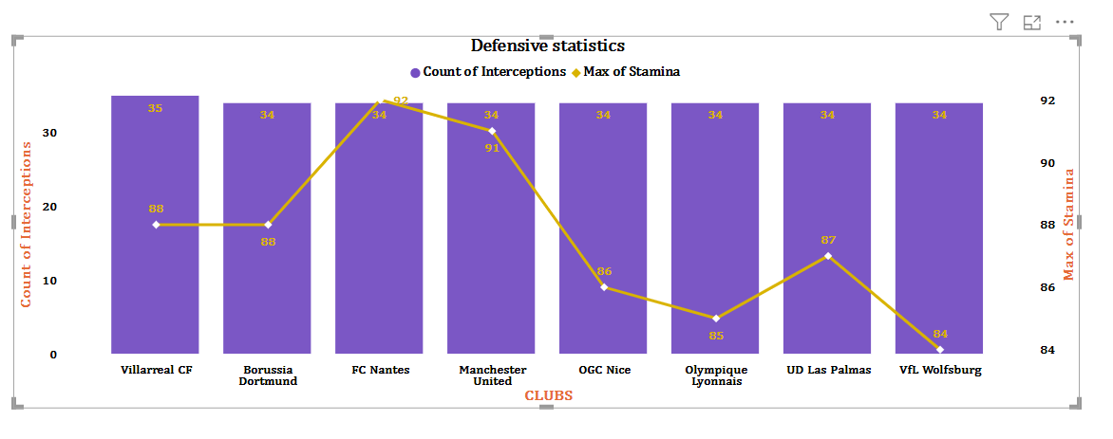
Understanding defensive metrics aids in crafting game plans that exploit the opponent's weaknesses or bolster the team's strengths.
Players with high stamina can maintain a high work rate, which increases their chances of being in the right place to intercept passes.
Stamina aids in maintaining focus and awareness, helping players read the game better and anticipate passes, which is key for successful interceptions.

Slide 15
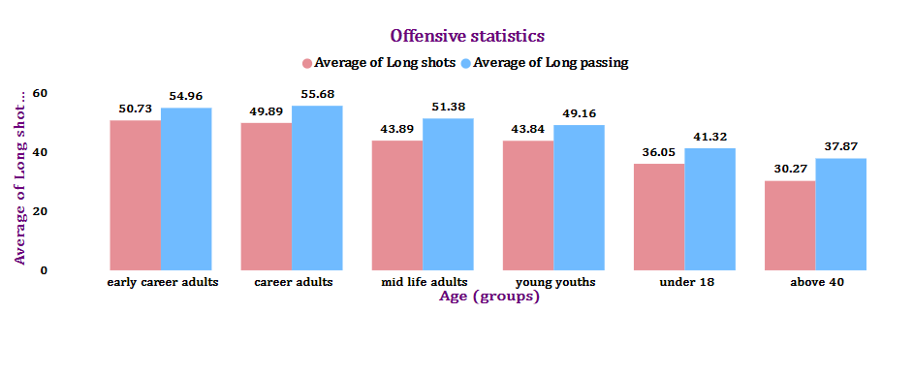
They are key aspects of offensive play.
By analyzing these statistics, We can gain valuable insights into their attacking strategies, player performance, and areas for improvement, ultimately leading to enhanced overall effectiveness on the pitch.
Career adults have great long passing skills
Early career adults has the highest long shots .

Slide 16
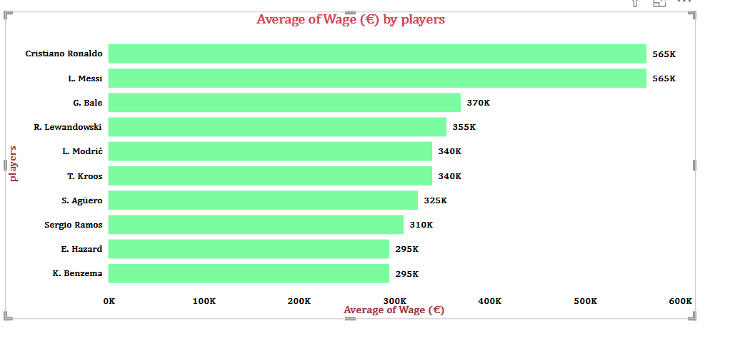
Higher average wages often indicate a team’s willingness to invest in talent.
CRISTIANO RONALDO (565K)
L. MESSI (565K)
G. BALE (370K)
They are expected to perform well in game , in turn puts a pressure on them which might affect player performance and morale.
high-profile players often see increased fan engagement and merchandise sales.

Slide 17
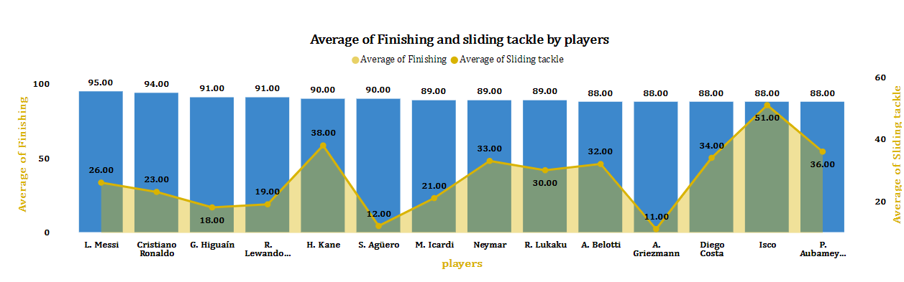
Players who excel in both fishing (intercepting passes) and sliding tackles may demonstrate a keen understanding of the game and good anticipation, suggesting they can read the opponent's intentions well.
L. MESSI (GREAT FINISHER)
ISCO (GREAT SLIDING TACKLER )
They are valuable for tactical adjustments during matches.

Slide 18
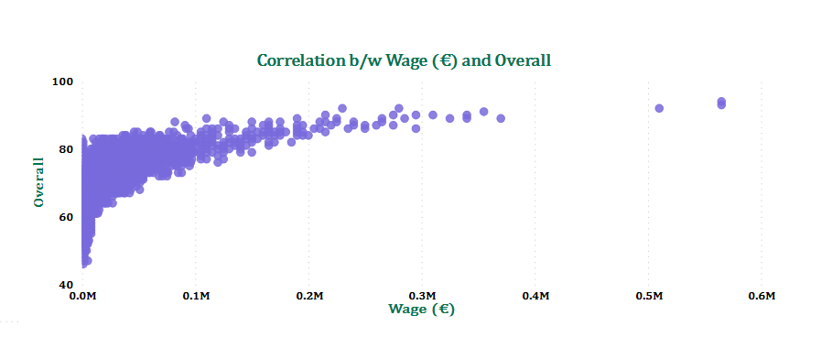
An upward correlation (+ve) suggests that as player potential increases, so does the market value, which could drive wage inflation in the sport. Clubs may need to adjust their wage structures to remain competitive.
This insight can inform decisions related to player recruitment, development, and financial planning, ultimately shaping a club’s success in the long term.

Slide 19
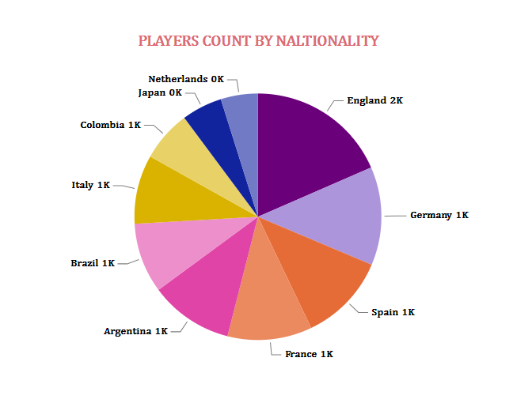
A diverse player pool can enhance team dynamics, bringing various playing styles, tactics, that enrich the team's performance.
England (2k)

Slide 20
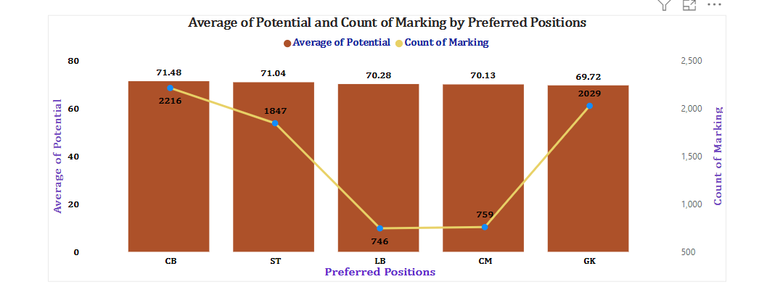
Tracking the development of marking skills over time in relation to potential can provide insights into a player's growth and readiness for higher levels of competition.
CB (centre back) highest
ST
LB ( MARKING )
It can help the clubs to build a balanced and competitive squad

Slide 21
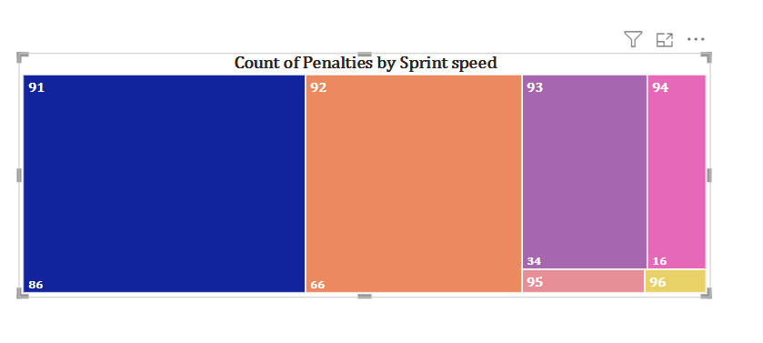
Analyzing the sprint speed of players who concede penalties can help to identify if slower defenders are more prone to fouling faster attackers.
Sprint speed 91 has more penalties of 86

Slide 22
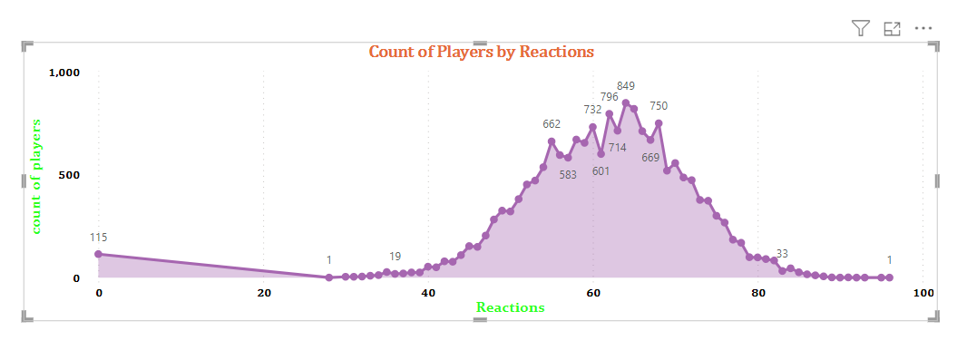
Players who consistently demonstrate quick reactions may be more effective in high-pressure situations.
“Reaction" refers to how quickly and effectively players respond to game situations.
Good reactions are crucial for maintaining possession, defending effectively, and capitalizing on scoring opportunities.
Players who has greatest reactions are 849 .

Slide 23
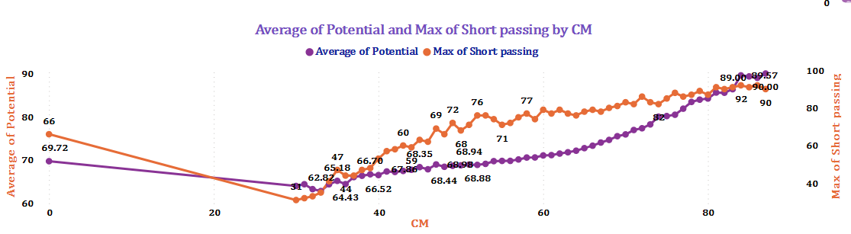
It can help to analyze the players who have room for improvement and those who are already performing at their highest level.
CMs with high average potential in short passing are likely to excel in playmaking roles, helping to control the game tempo and create scoring opportunities.
CM =87 HAS THE HIGHEST OF BOTH

Slide 24
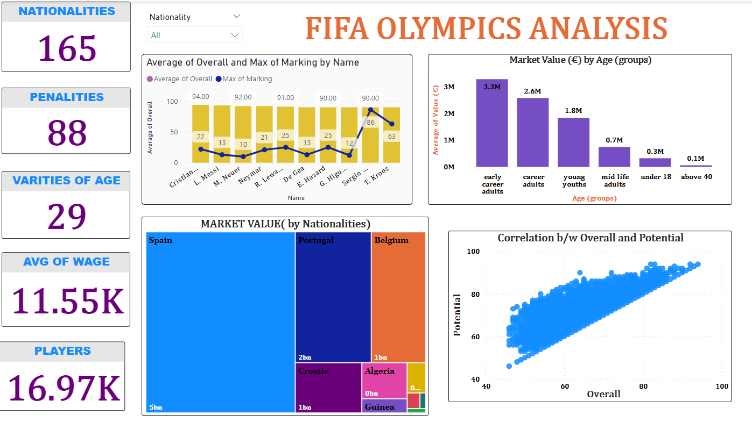
DASHBOARD

Slide 25
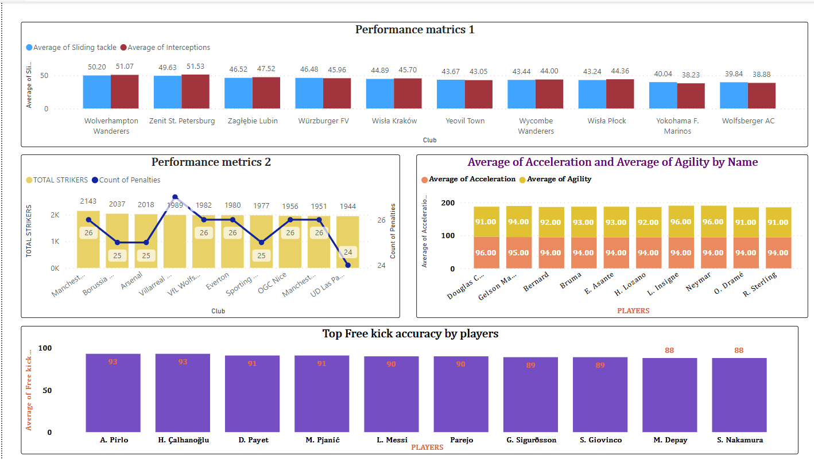

Slide 26
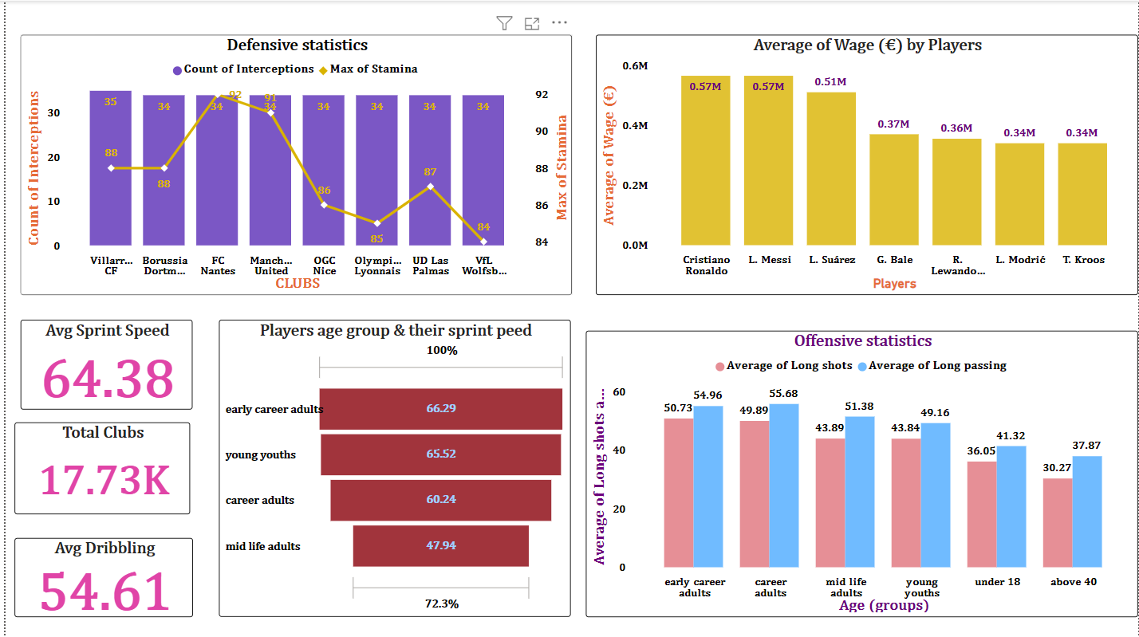

Slide 27

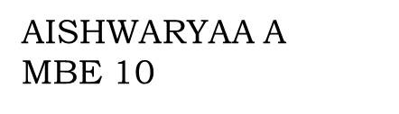
“THE IMPORTANT THING IN THE OLYMPIC GAMES IS NOT TO WIN , BUT TO TAKE PART “
-PIERRE DE COUBERTIN
THANK YOU

